Slide 1
Angry Bird Clone
Developed
by
Ali Haydar AYAR

Slide 2
GamePlay & UI
Entry:
When our game is opened, a menu welcomes us as seen on the right.
Here we can start a new game or continue if we have an existing save or choose a level according to our progress.
Optionally there is a button to delete the current save.

Slide 3
GamePlay & UI
Gameplay:
Our game has almost the same mechanics as a clone of the angry bird game in the industry.
By holding down the bird with the mouse, dragging it and releasing it, we can give movement to our bird. By hitting obstacles and monsters on the stage, we can destroy them and earn points.

Slide 4
GamePlay & UI
Complation of level:
Failing of level:
We need to complete the level by destroying all the monsters on the stage.
If the 8 bird rights given to us reach 0, we fail.

Slide 5
GamePlay & UI
Saving Game:
We can only save the game when we complete an any level. We can access the levels from the load level section in the main menu.

Slide 6
GamePlay & UI
Pausing game:
We can pause the game at any time by pressing the ESC key and resume it by pressing it again or by clicking the resume button on the UI.

Slide 7
Scene & UI Logics
Scene interactions and UI:
Level 1
MainMenu
If there is a saved game, it opens that scene.
Continue Game
Game States:
Resume Game
New Game
InGame
Next Level
If there is a saved game, you can load any level you want.
Load Game
Restart Level
Paused
Delete Save
If there is a saved game , you can delete it.
Return Menu
Won
Exit Game
Save&Return Menu
Lost
Level N
Level 3
Level 2

Slide 8
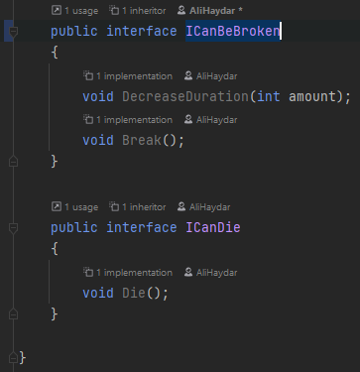
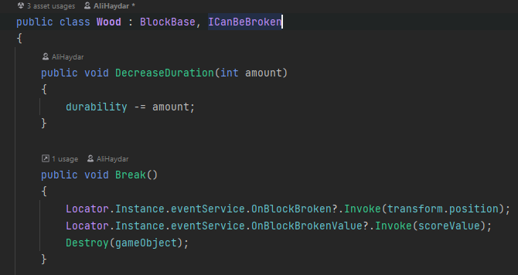
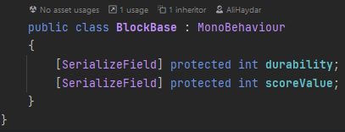
Code Examples
Interface:
Inheritance:

Slide 9
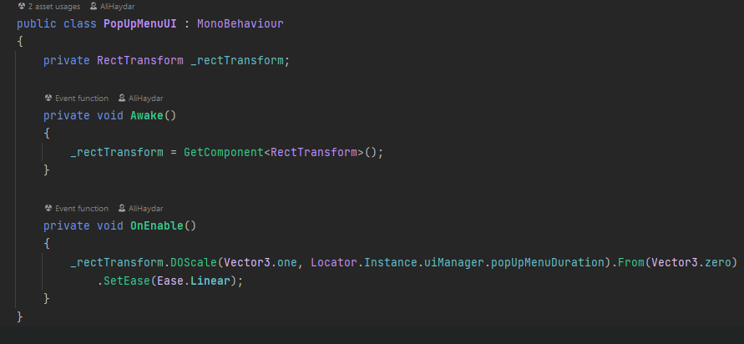
Code Examples
DoTween:

Slide 10
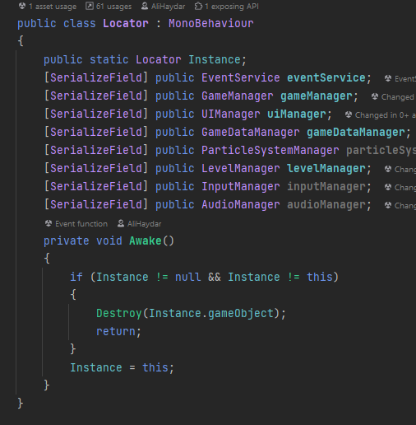
Code Examples
Static Object(Singleton Design Pattern):

Slide 11
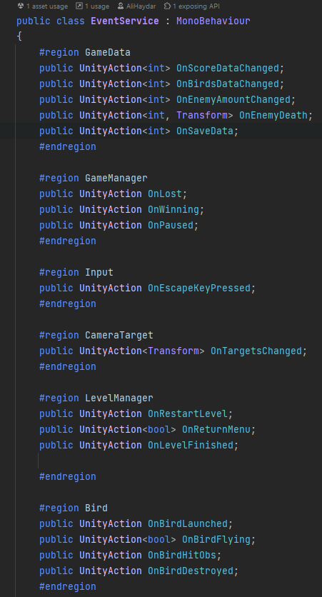
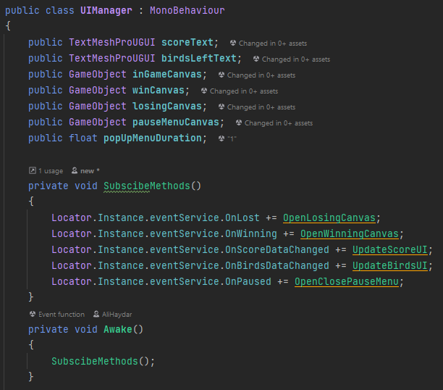
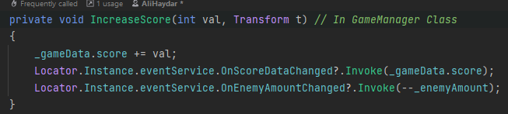
Code Examples
UnityAction(EventSytem):

Slide 12
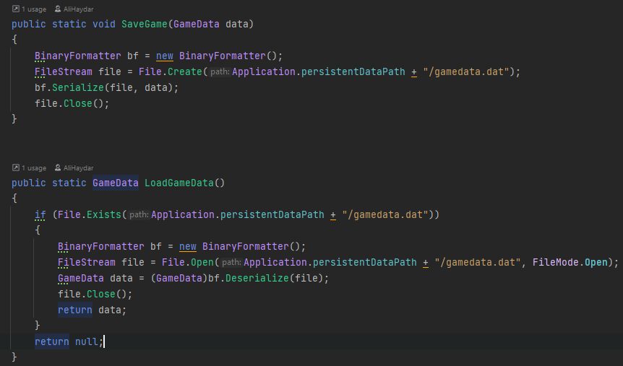
Code Examples
Persisted Data(Saving data to file):

Slide 13
Thank You

